Slide 1
Methodology – served prediction
Pick a sample of 267 placements from 20 accounts: 10 large, 5 medium and 5 small.
Count “served_tag_network” column in RedShift by: placement, date, network.
Run a similar query on kmn_cpm, and match the data.
Filter rows of less than 500 events.
Calculate a “deviation” metric for the difference in served (mysql vs. RS)
Predict deviation 1-day-ahead using moving average, testing window sizes of between 1 and 5 days.

Slide 2
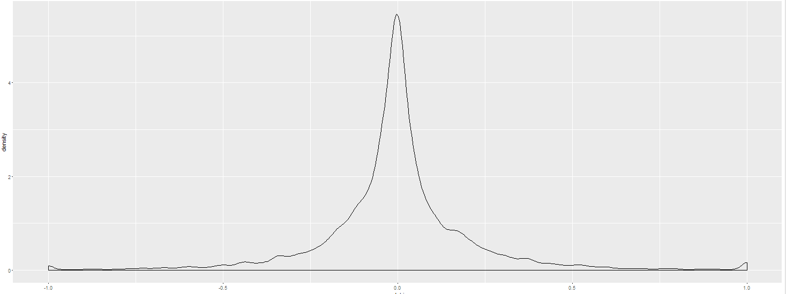
Served prediction Result
Proposed model: 1-day moving-average of the deviation between served data in RS and in MySql.
Mean absolute prediction error on sample data: 13%.

Slide 3
Served prediction with safety margin
Estimation error of more than 5% is to be expected in a certain percentage of case.
In order to reduce frequency of over-estimation, one technique is to display to clients figures that are deliberately lower than projected
The result is higher incidence of under-estimation.
Bias | % accurate (±5%) | % somewhat nonaccurate | % severe downward error | % severe upward error
No bias | 57% | 30% | 6% | 7%
10% down | 11% | 64% | 23% | 2%

Slide 4
eCPM prediction
Current method of eCPM prediction
Based on model per network per order
If model is missing, uses tag’s own history, or a similar tag
Suggested method
When available – tag’s own recent performance (if exists and floor price hasn’t changed)
When not available, model should be based on tag’s floor price with a network-specific coefficient:
OpenX, 1.18
Adx, 1.11
Index, 1.01
PlusePoint, 1.00
Pubmatic, 0.99
AOL, 0.90
Overall, eCPM prediction accuracy of 5-6% is expected

Slide 5
eCPM contribution to accuracy
eCpm from own tag: 2-3% error
eCpm from network and floor price: 5% error
Served (after filtering OpenX, Smaato, Index, Adx):

Slide 6
Ratio of placement by frequency of: days within 10% of actual value
criterion | 100% of days within | 95% of days within | 90% or more | 85% | 80% | 70% | 60% | 50%
Percent of placements within criterion | 26% | 26% | 40% | 54% | 63% | 75% | 86% | 92%
Ratio of placement by frequency of: days within 20% of actual value
criterion | 100% of days within | 95% of days within | 90% or more | 85% | 80% | 70% | 60% | 50%
Percent of placements within criterion | 62% | 62% | 80% | 86% | 90% | 94% | 98% | 99%

Slide 7
Ratio of placement by frequency of: days within 10% of actual value
criterion | 100% of days within | 95% of days within | 90% or more | 85% | 80% | 70% | 60% | 50%
% placements within criterion | 26% | 26% | 40% | 54% | 63% | 75% | 86% | 92%
% sites within criterion | 42% | 42% | 57% | 68% | 84% | 94% | 94% | 94%
Ratio of placement by frequency of: days within 20% of actual value
criterion | 100% of days within | 95% of days within | 90% or more | 85% | 80% | 70% | 60% | 50%
% placements within criterion | 62% | 62% | 80% | 86% | 90% | 94% | 98% | 99%
% sites within criterion | 68% | 68% | 79% | 84% | 90% | 94% | 100% | 100%

Slide 8
Another View
If you’re a publisher, you can expect
Accuracy level expected in 70% of days on 70% of placements: ±10%
Accuracy level expected in 80% of days on 80% of placements: ±15%
Accuracy level expected in 90% of days on 90% of placements: ±25%
Pending examination of within-publisher correlation
\/ Days \ placements | 70 | 80 | 90
70 | ±10% | ±12% | ±17%
80 | ±12% | ±15% | ±21%
90 | ±15% | ±19% | ±25%

Slide 9
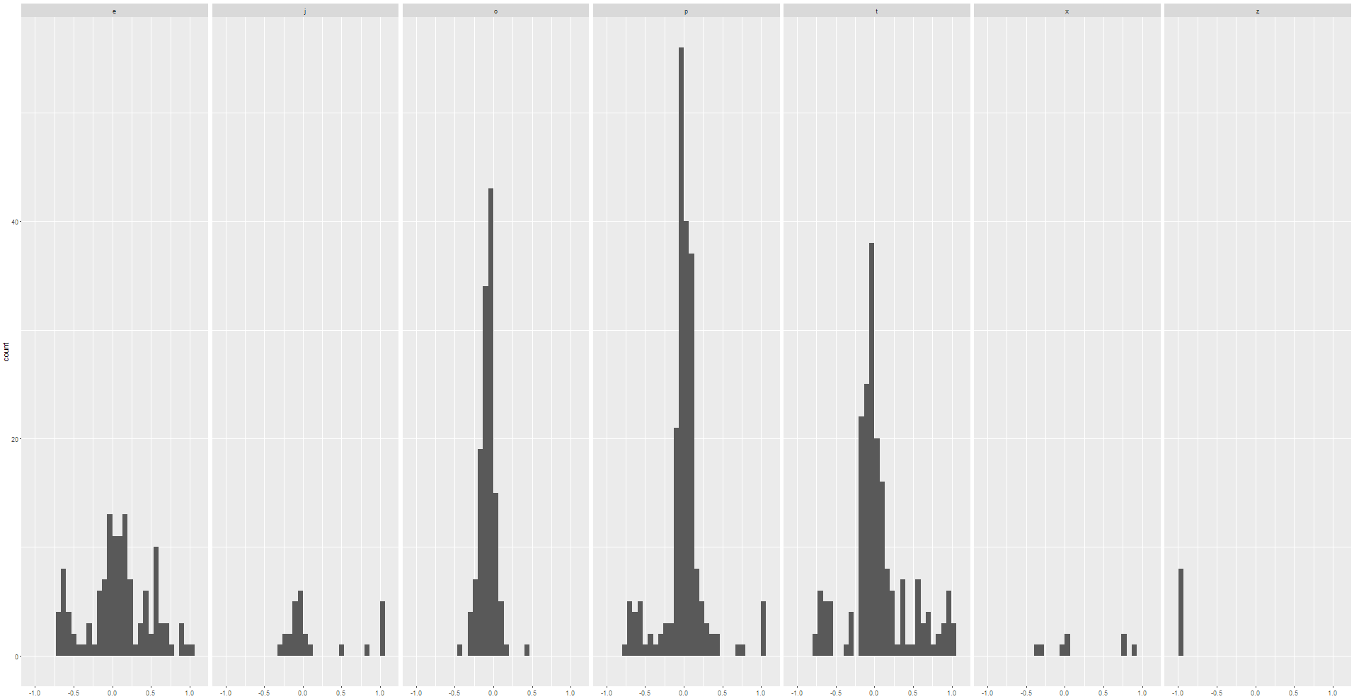
Deviation per network (count of rows with each deviation between -1 and 1)
OpenX
Index
AOL
Pubmatic
PulsePoint
Adx
Smaato
0’s in redshift
0’s in mysql

Slide 10
Important notes
For the dates 3/3 – 5/3, far fewer served events appeared in RS than actual number. This affected almost all placements and networks. “Representation rate” dropped on these days from around 90% to about 40%. These dates were ignored in the analysis presented in earlier slides.
AOL deviations have a similar pattern (deviation per day) across many placements from several users. This non-random effect should be investigated. See next slide.
Smaato deviation is -98%, i.e. less than 2% of served events are detected.
MySql data was substantially incomplete for both 13/3 and 14/3 (data was retrieved early afternoon on 15/3).

Slide 11
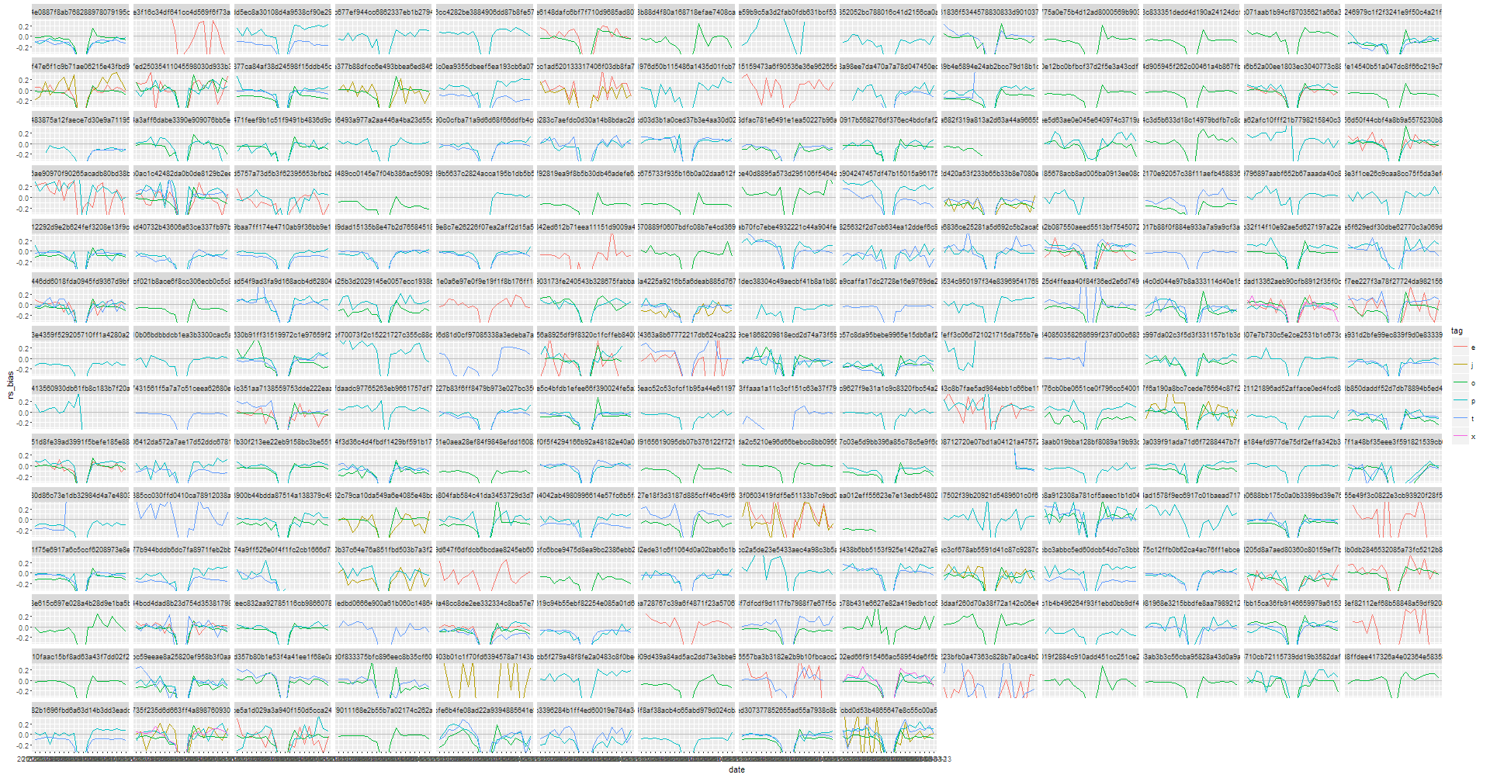
Deviation time-series: tile = placement, color=network. The “bad days” are the dip in the middle of each x-axis. Placements with similar AOL pattern are framed.

Slide 12
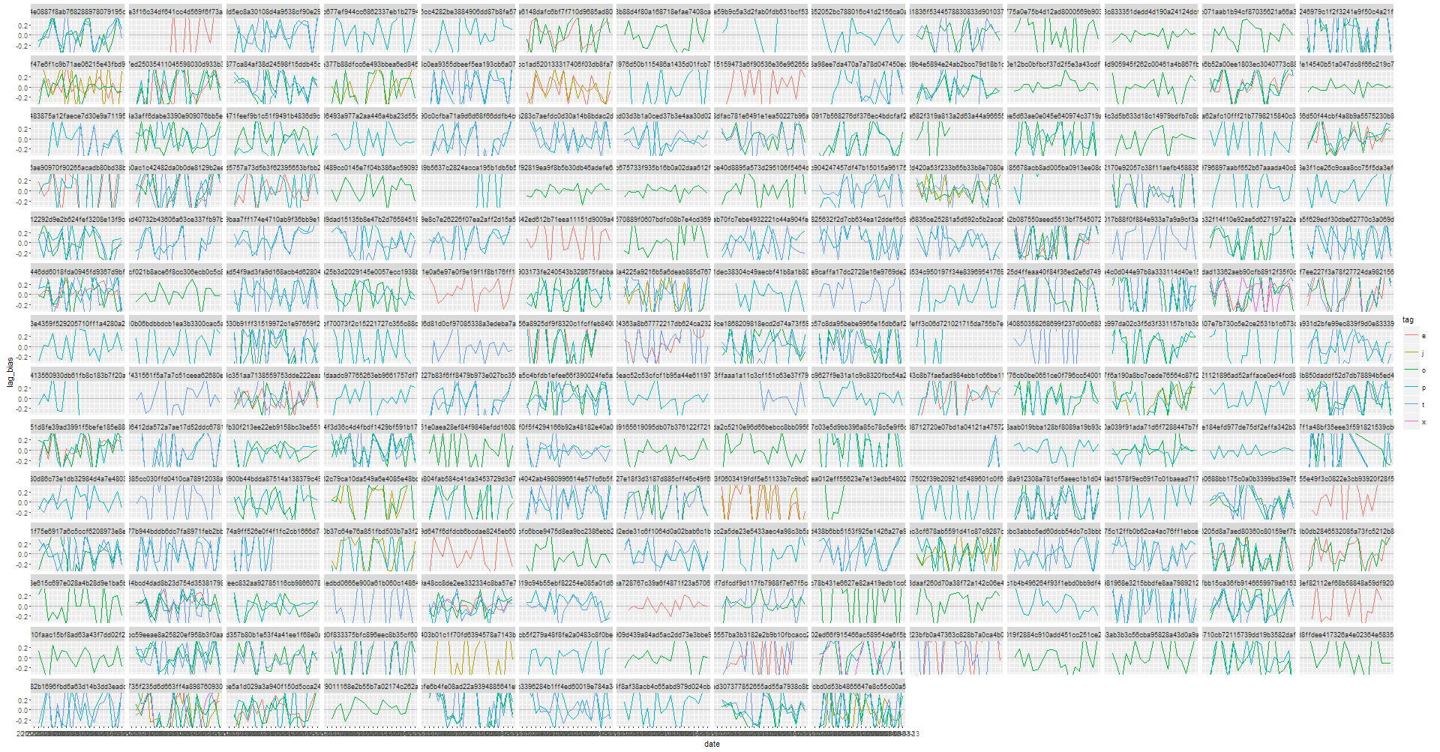
served day over day relative change: tile = placement, color=network

Slide 13
Technical details
RS rows:
Total: 25763
Served network == “h”: 5399
Served network blank: 5387 (21%)
--> Rows expected to be matched in mysql: 14977
RS rows unmatched by a corresponding MySql row: 999, most of them from 13/3 and 14/3 (data was collected on 15/3).
Rows from MySql with at least 10 served, but no matching RS data: 22 rows.
16 of them are smaato.
Average served count in these 22 unmatched rows: 97.

Slide 14
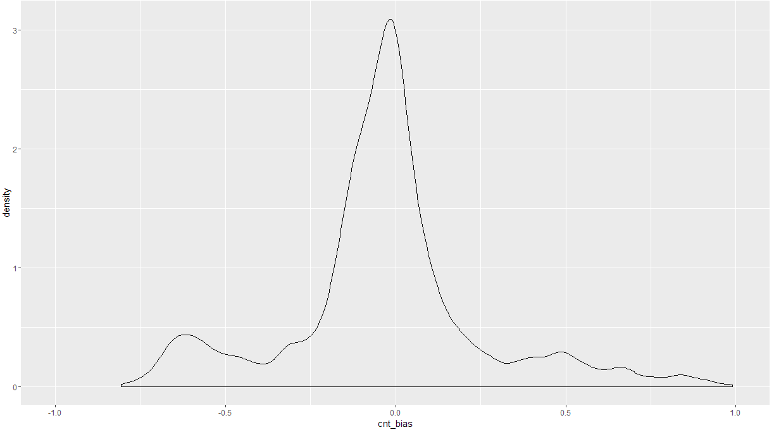
No filtering

Slide 15
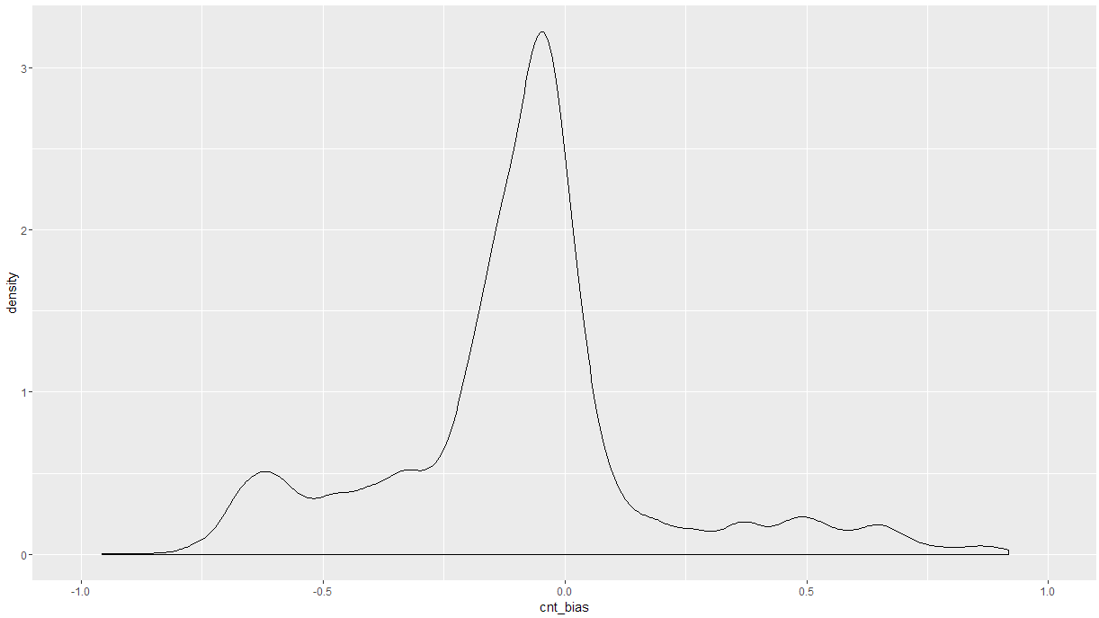
With Filtering
Seems that filtering js-errs will allow us to better set an upper bound to the estimation and avoid upward errrors

